Slide 1
Gradient Descent
Updates
NETSOL Cohort II

Slide 2
One Parameter
Given:
J(w) = (w - 5)²
w₀ = 1
α = 0.25
Find:
w₁
w₂

Slide 3
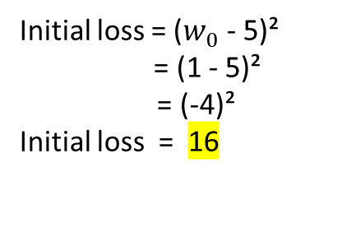
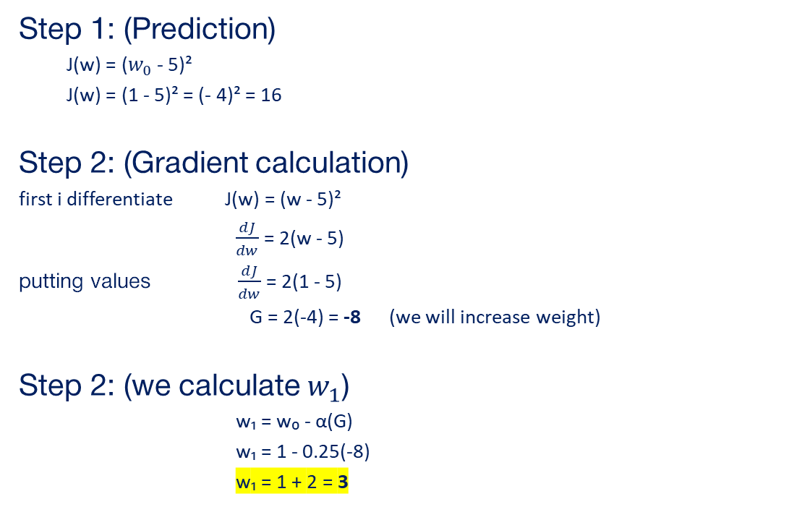
Step 1: (Prediction)
  J(w) = ($w_{0}$ - 5)²
  J(w) = (1 - 5)² = (- 4)² = 16
Step 2: (Gradient calculation)
first i differentiate J(w) = (w - 5)²
$\frac{dJ}{dw}$ = 2(w - 5)
putting values $\frac{dJ}{dw}$ = 2(1 - 5)
G = 2(-4) = -8 (we will increase weight)
Step 2: (we calculate $w_{1}$)
w₁ = w₀ - α(G)
w₁ = 1 - 0.25(-8)
w₁ = 1 + 2 = 3
Initial loss = ($w_{0}$ - 5)²
= (1 - 5)²
= (-4)²
Initial loss = 16

Slide 4
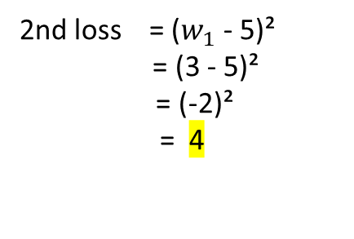
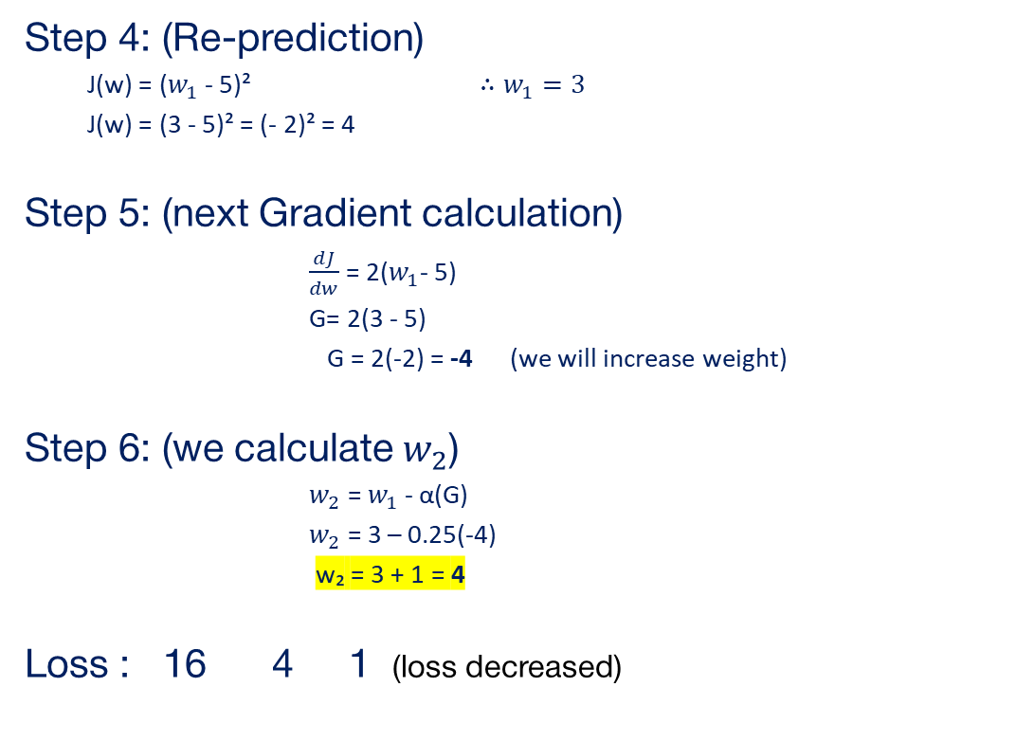

2nd loss = ($w_{1}$ - 5)²
= (3 - 5)²
= (-2)²
= 4
Step 4: (Re-prediction)
  J(w) = ($w_{1}$ - 5)² $∴w_{1}=3$
  J(w) = (3 - 5)² = (- 2)² = 4
Step 5: (next Gradient calculation)
$\frac{dJ}{dw}$ = 2($w_{1}$- 5)
G= 2(3 - 5)
G = 2(-2) = -4 (we will increase weight)
Step 6: (we calculate $w_{2}$)
$w_{2}$ = $w_{1}$ - α(G)
$w_{2}$ = 3 – 0.25(-4)
w₂ = 3 + 1 = 4
Loss : 16 4 1 (loss decreased)
3rd loss = ($w_{2}$ - 5)²
= (4 - 5)²
= (-1)²
= 1

Slide 5
Two Parameter
Given:
J(a , b) = (a - 2)² + (b + 1)²
a = 0
b = 1
α = 0.1
Find:
Gradient (∇J)
next point

Slide 6
  initial loss = (a - 2)² + (b + 1)²
  = (0 - 2)² + (1 + 1)²
  = (-2)² + (2)²
  = 4 + 4 = 8
Step 1: (Prediction)
  J(a , b) = (a - 2)² + (b + 1)²
  = (0 - 2)² + (1 + 1)²
  = (-2)² + (2)²
  = 4 + 4 = 8
Step 2: (Gradient calculation)
first i differentiate with respect to a :
∂J/∂a = 2(a - 2)
now i differentiate with respect to b:
∂J/∂b = 2(b + 1)
putting value ∂J/∂a = 2(0 - 2)
= 2(-2) = - 4
∂J/∂b = 2(1 + 1)
= 2(2) = 4
∇J = (-4, 4)

Slide 7
Step 3: (Calculate the next point)
a₁ = a₀ - α(∂J/∂a)
b₁ = b₀ - α(∂J/∂b)
a₁:
a₁ = 0 - 0.1(-4)
a₁ = 0 + 0.4 = 0.4
b₁:
b₁ = 1 - 0.1(4)
b₁ = 1 - 0.4= 0.6
So:
next point = (0.4, 0.6)
Loss : 8 5.12 (loss decreased)
  2nd loss = (a - 2)² + (b + 1)²
  = (0.4 - 2)² + (0.6 + 1)²
  = (-1.6)² + (1.6)²
  = 2.56 + 2.56 = 5.12

